Slide 1
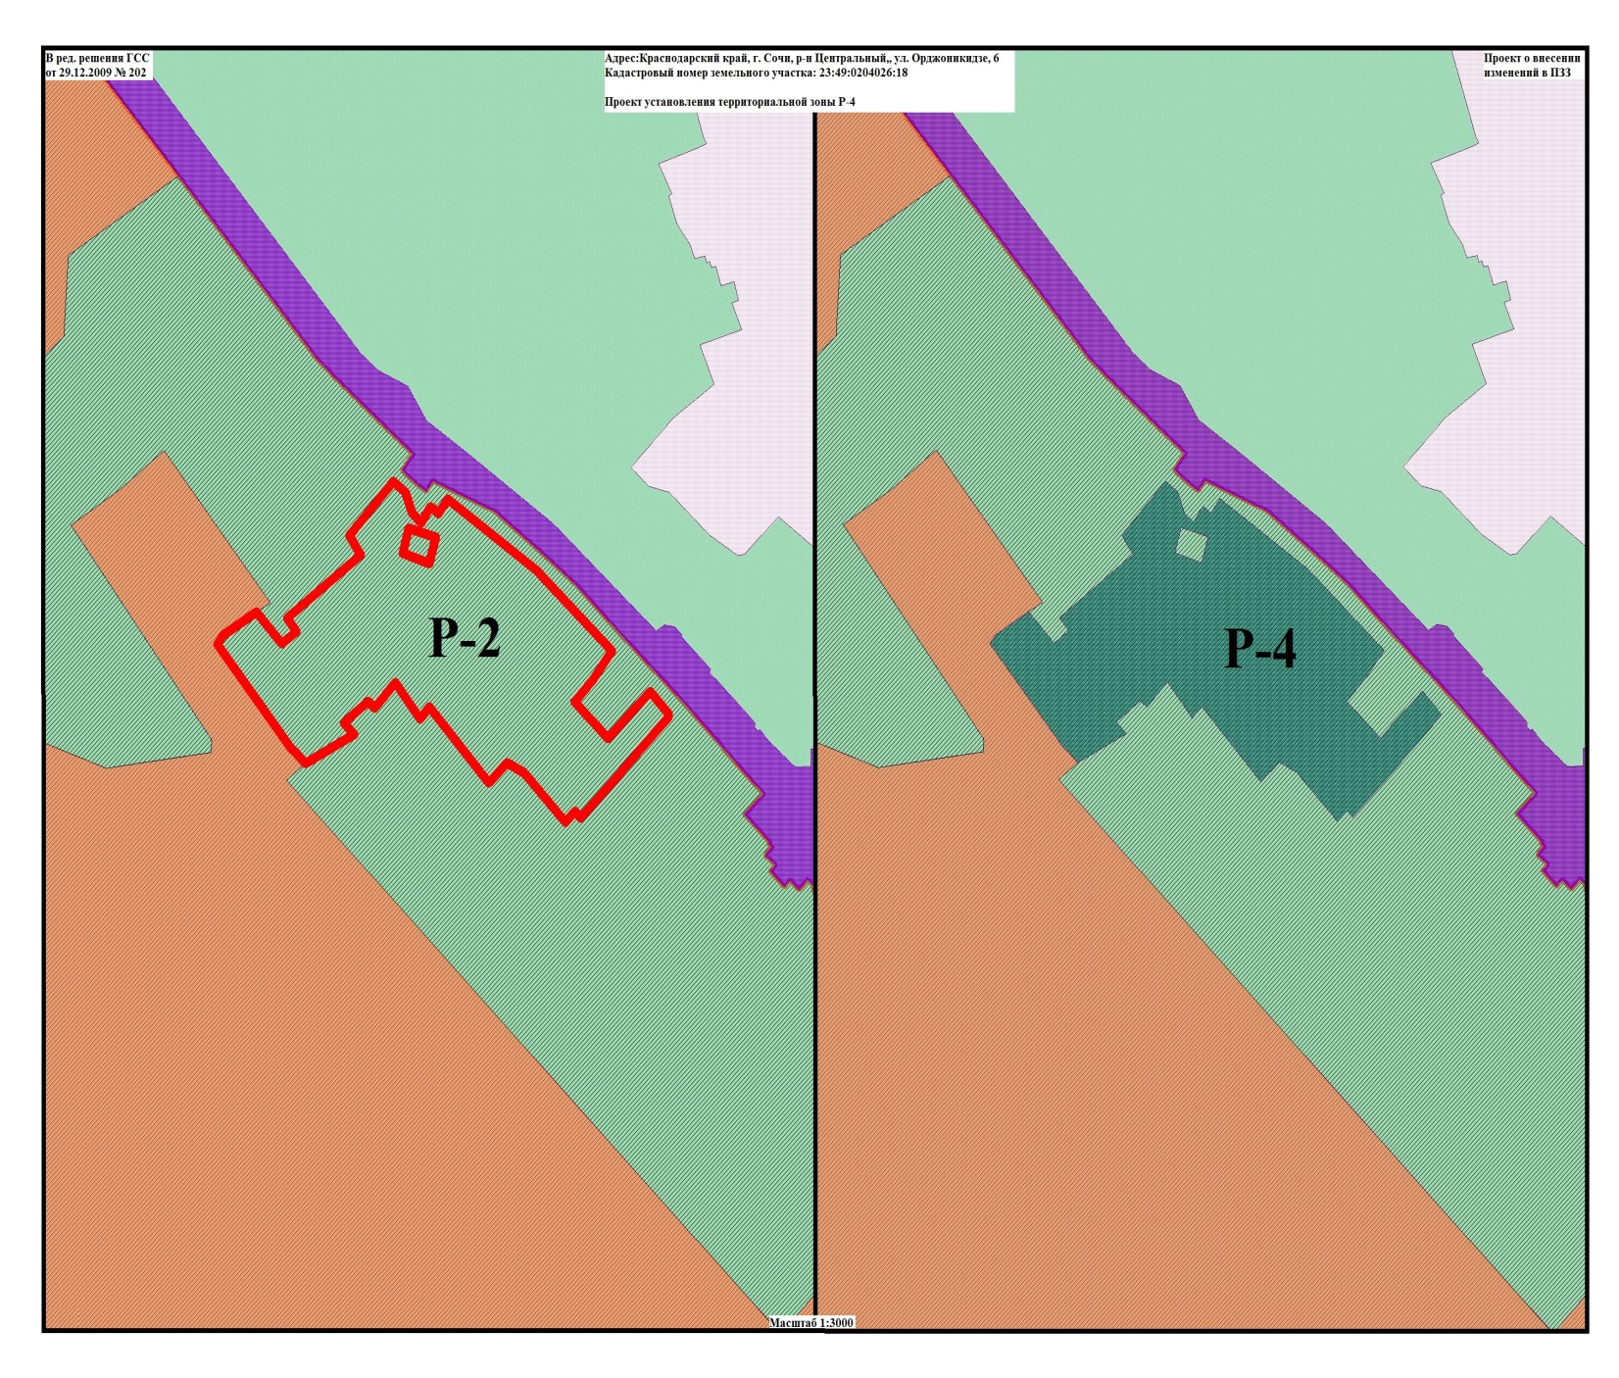
2
Каталог координат границы территориальной зоны Р-4
№ X Y
1 42698,9015 58784,6971
2 42703,1009 58788,8277
3 42700,4975 58791,2203
4 42711,6990 58802,5053
5 42740,3847 58830,1563
6 42741,2974 58830,2645
7 42750,0133 58822,0549
8 42749,2899 58821,0820
9 42749,0074 58820,9787
10 42740,7506 58812,3840
11 42731,8070 58803,5056
12 42746,0387 58788,7931
13 42754,6989 58796,6880
14 42765,9923 58805,1202
15 42797,6152 58771,8689
16 42812,1092 58751,7990
17 42825,6155 58732,6728
18 42819,9578 58728,6270
19 42821,4702 58726,6205
20 42822,5725 58725,0339
21 42816,2677 58721,1136
22 42820,0870 58716,8616
23 42828,2341 58714,1566
24 42831,5300 58709,7671
25 42832,5015 58708,5637
26 42830,7687 58707,2047
27 42811,3098 58689,3955
28 42803,7434 58694,2171
№ X Y
29 42778,8849 58661,8038
30 42773,5321 58665,9223
31 42768,9363 58659,4307
32 42773,7547 58655,1349
33 42781,3351 58648,3826
34 42772,1236 58633,7295
35 42771,0501 58632,7549
36 42768,7337 58631,2499
37 42727,9466 58663,5597
38 42726,2473 58665,7007
39 42721,8711 58670,0860
40 42733,3029 58691,4375
41 42737,9743 58686,8451
42 42746,2352 58697,7101
43 42743,5211 58700,4954
44 42753,5413 58709,6382
45 42739,4305 58720,6171
46 42744,1932 58724,4642
47 42714,2432 58750,6942
48 42722,0910 58758,9186
49 42718,2310 58766,4922
1 42698,9015 58784,6971
50 42800,4264 58724,5423
51 42804,2676 58712,8283
52 42814,1039 58715,5241
53 42810,5369 58727,4116
50 42800,4264 58724,5423

