Slide 1
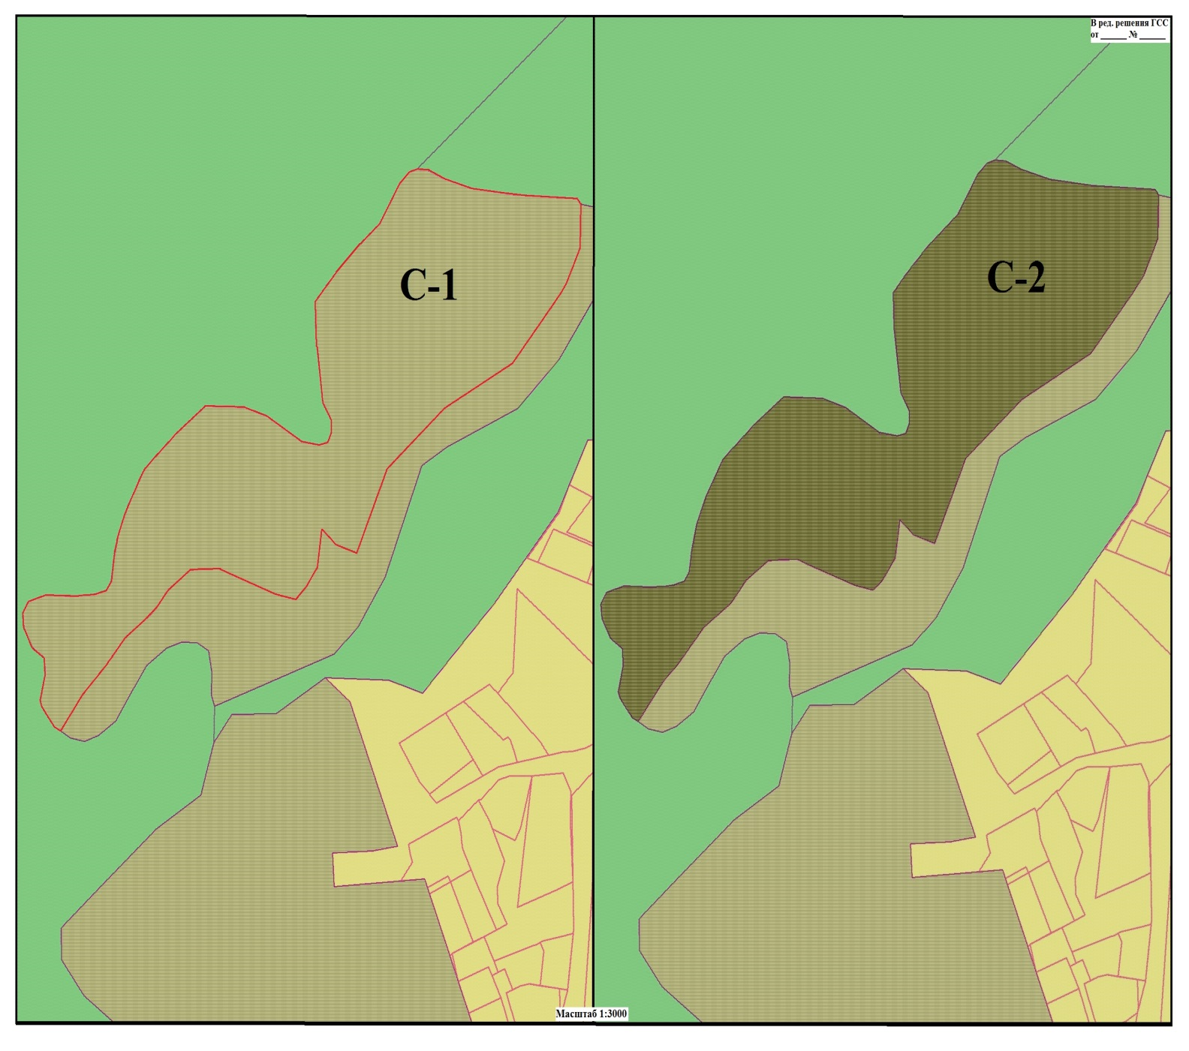
3
Каталог координат границы территориальной зоны С-2
№ X Y
1 57543,4487 55190,0997
2 57545,6077 55186,2773
3 57552,4052 55181,1037
4 57556,3443 55178,1089
5 57560,0351 55176,8604
6 57562,2170 55177,3383
7 57574,3131 55180,0094
8 57584,0694 55179,7760
9 57590,1578 55171,7188
10 57600,9499 55165,8695
11 57609,0760 55165,2250
12 57615,9132 55169,2322
13 57619,2202 55180,7853
14 57618,9046 55196,8559
15 57619,1713 55208,0016
16 57620,0047 55213,5727
17 57622,0562 55220,7250
18 57627,0554 55223,9960
19 57639,2405 55225,7848
20 57653,5551 55228,7930
21 57669,2194 55235,1194
22 57690,4318 55246,7542
23 57709,7857 55267,6651
24 57724,9206 55286,9767
25 57724,2821 55312,5468
26 57719,2150 55328,1710
27 57705,0918 55350,7231
28 57703,2930 55362,9085
29 57704,6728 55368,3265
30 57710,1805 55370,6952
31 57716,8780 55370,5349
32 57727,1706 55365,1277
33 57763,4536 55360,3688
34 57783,1461 55359,8976
35 57793,4893 55368,3118
№ X Y
36 57809,0499 55382,8422
37 57826,8558 55403,0101
38 57850,1495 55416,7754
39 57855,6674 55422,9146
40 57857,2807 55427,6369
41 57856,8524 55434,8185
42 57852,3368 55445,0685
43 57846,5258 55464,3012
44 57843,0255 55492,7403
45 57841,0555 55534,5554
46 57837,6375 55536,7576
47 57813,5608 55536,2535
48 57792,7312 55526,8200
49 57783,1209 55519,7786
50 57749,2221 55491,6742
51 57723,4789 55445,7613
52 57690,5148 55408,2328
53 57643,0704 55387,5238
54 57647,7505 55373,2792
55 57656,3008 55364,4430
56 57634,5903 55361,2517
57 57621,7960 55352,3961
58 57616,8151 55346,5442
59 57619,6754 55334,4134
60 57630,7812 55304,0520
61 57634,0912 55296,0813
62 57633,8434 55285,7253
63 57633,2904 55276,8268
64 57622,6787 55262,2079
65 57609,7003 55251,9265
66 57596,1985 55233,9861
67 57574,6946 55216,0171
68 57566,8228 55207,6438
1 57543,4487 55190,0997

